Slide 1
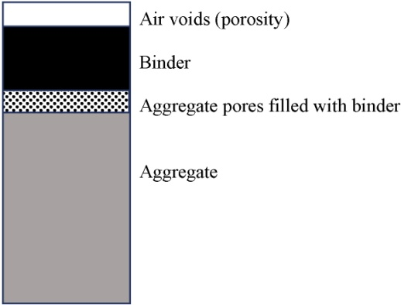
FIGURE 37.1 Components of a Compacted Sample of Asphaltic Concrete
Copyright © 2016 Elsevier Ltd. All rights reserved.

Slide 2
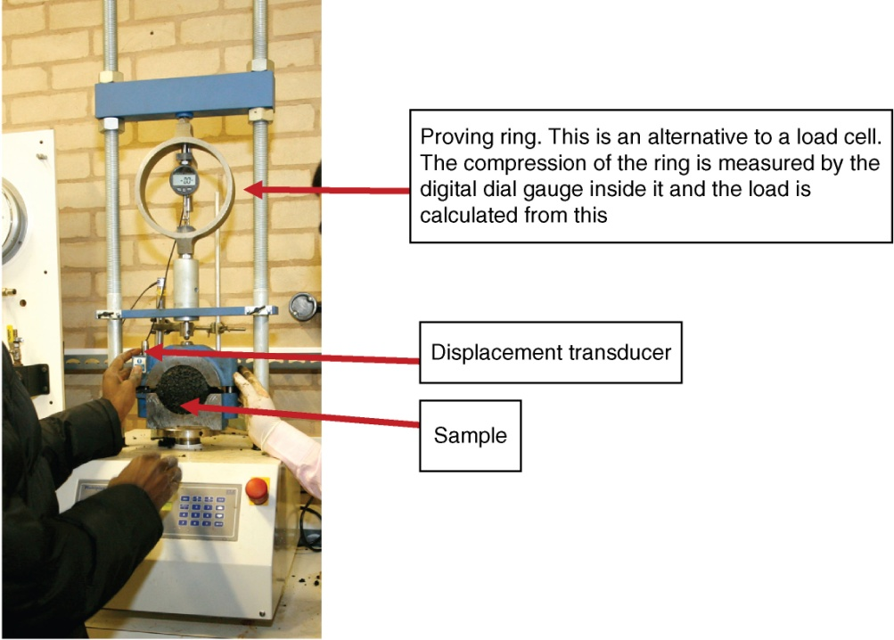
FIGURE 37.2 The Marshall Test
Copyright © 2016 Elsevier Ltd. All rights reserved.

Slide 3
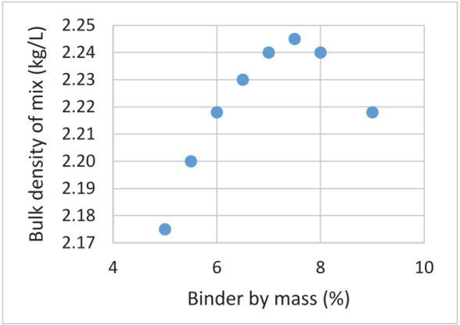
FIGURE 37.3 Bulk Density of Mix
Copyright © 2016 Elsevier Ltd. All rights reserved.

Slide 4
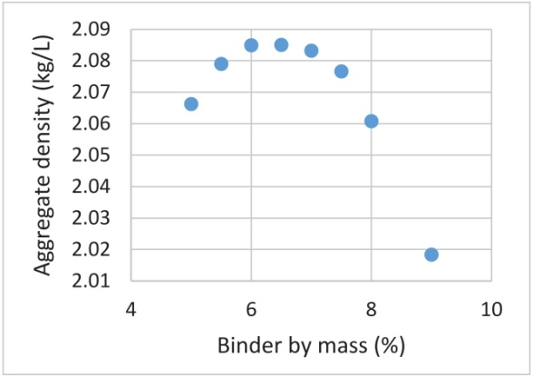
FIGURE 37.4 Aggregate Density
Copyright © 2016 Elsevier Ltd. All rights reserved.

Slide 5
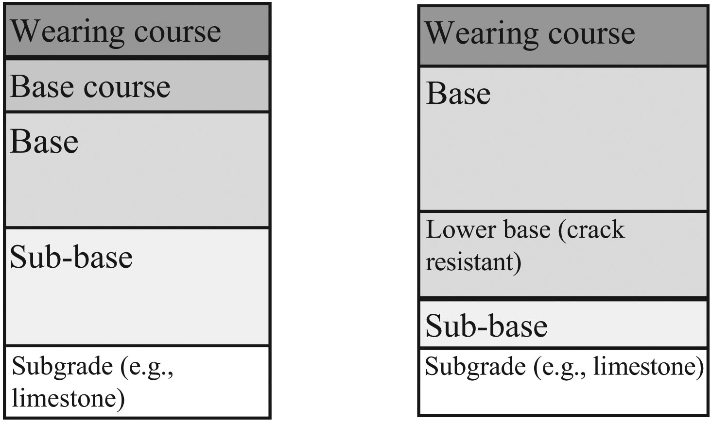
FIGURE 37.5 Pavement Types
Copyright © 2016 Elsevier Ltd. All rights reserved.

Slide 6
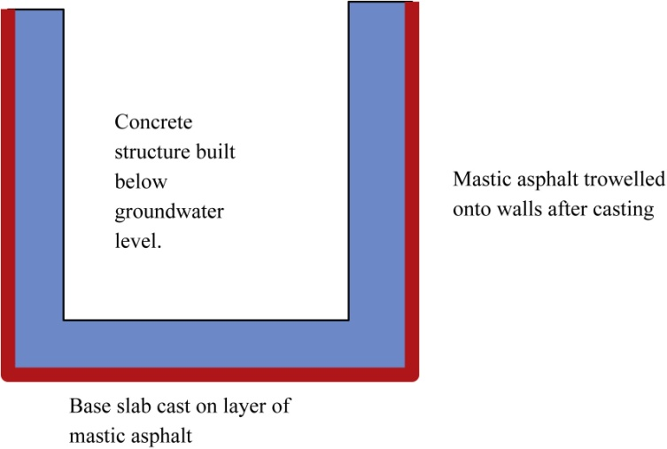
FIGURE 37.6 Schematic Diagram of Mastic Asphalt Tanking
Copyright © 2016 Elsevier Ltd. All rights reserved.

